Slide 1
Sentiment Analysis
Twitter Sentiment – Trump, Elon Musk, Blackrock etc
News Impact
Fear and Greed Index
FOMC Meeting
CPI/PPI Data
Cryptocurrency Specific Events
BTC Halving
Eth Upgrades
Major Exchange Listings
Macro Events
Geo Political Tension
Bank Collapses or Financial Crisis
Notes:
Steps for Sentiment Analysis:
Use Sentiment Indicators:
Crypto Fear & Greed Index (alternative.me).
Social media buzz (Twitter, Reddit mentions).
Google Trends for crypto-related keywords.
News & Social Media Monitoring:
Track crypto news portals (CoinDesk, CoinTelegraph).
Monitor influencers’ posts and opinions.
Use tools like LunarCrush or Santiment for social metrics.
Volume & Funding Rates:
Analyze funding rates on derivatives exchanges (positive funding = bullish sentiment).
Track trading volume surges (often tied to hype or panic).
Community Sentiment:
Twitter sentiment analysis (using tools like TweetSentiment or Glassnode’s sentiment reports).
Reddit threads (r/Bitcoin, r/CryptoMarkets).

Slide 2
On chain Analysis
On-chain analysis looks directly at blockchain data (transactions, addresses, etc.) to assess investor behavior.
Steps for On-Chain Analysis:
Check Active Addresses & Transactions:
Increasing active addresses = more network activity (bullish).
Tools: Glassnode, IntoTheBlock, CryptoQuant.
Whale Activity:
Monitor wallets holding 1,000+ BTC.Track whale inflows/outflows on Glassnode or WhaleAlert.

Slide 3
Risk Management and Trading Psychology

Slide 4
Risk Management in Trading
Volatility: Understanding and managing the inherent risk of volatile markets.
Setting stop-loss orders and take-profit levels.
Diversification: Not putting all your funds in one asset.
Avoiding emotional trading and FOMO (Fear of Missing Out).
Using only what you can afford to lose in crypto investments.

Slide 5
Common Mistakes to avoid
Overtradig
Chasing losses or overleveraging.
Falling for “pump-and-dump” schemes.
Lack of a solid trading plan.
Failing to understand the technology behind the coin you are trading.

Slide 6
Trading Styles
Scalping
Intraday Trading
Swing Trading
Position Trading

Slide 7
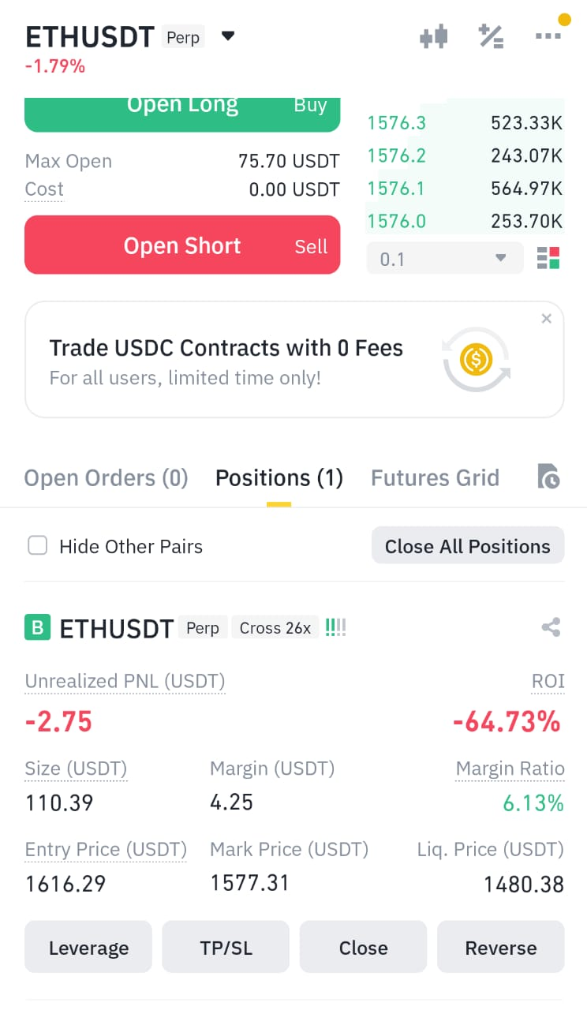
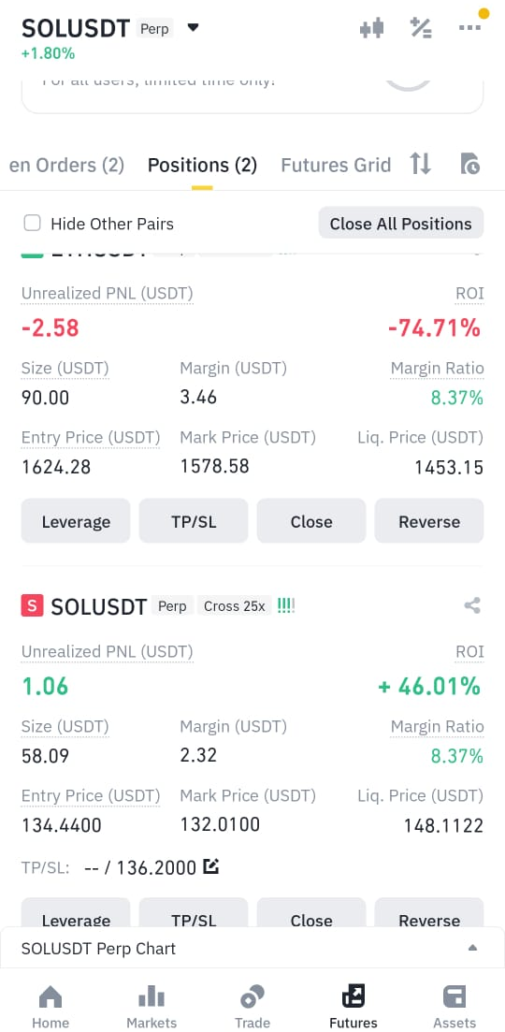
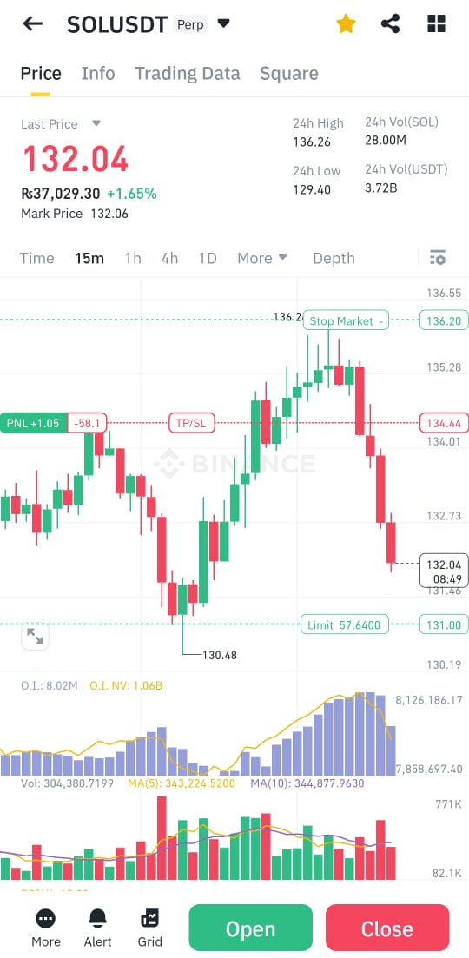
Position Strategies

Slide 8
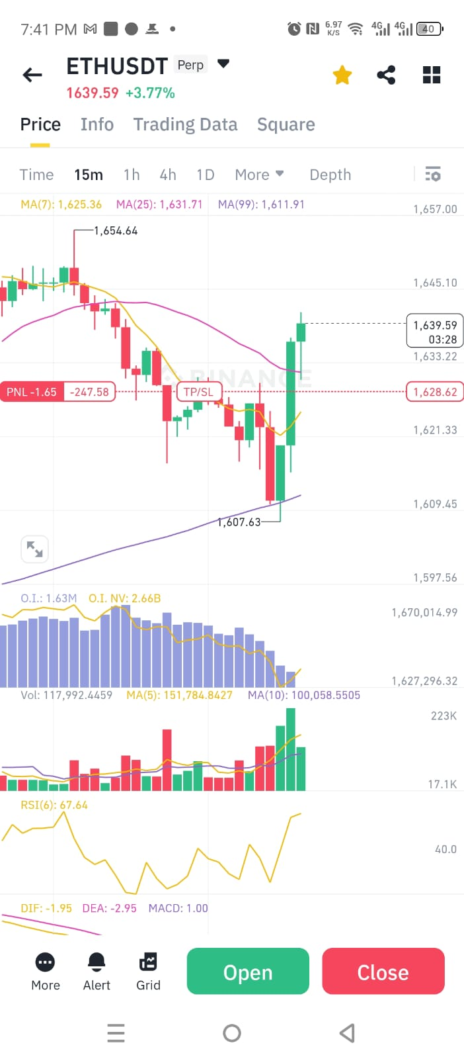
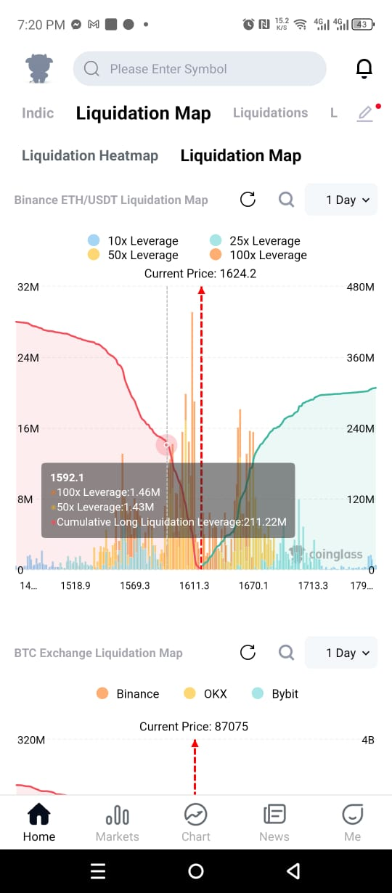
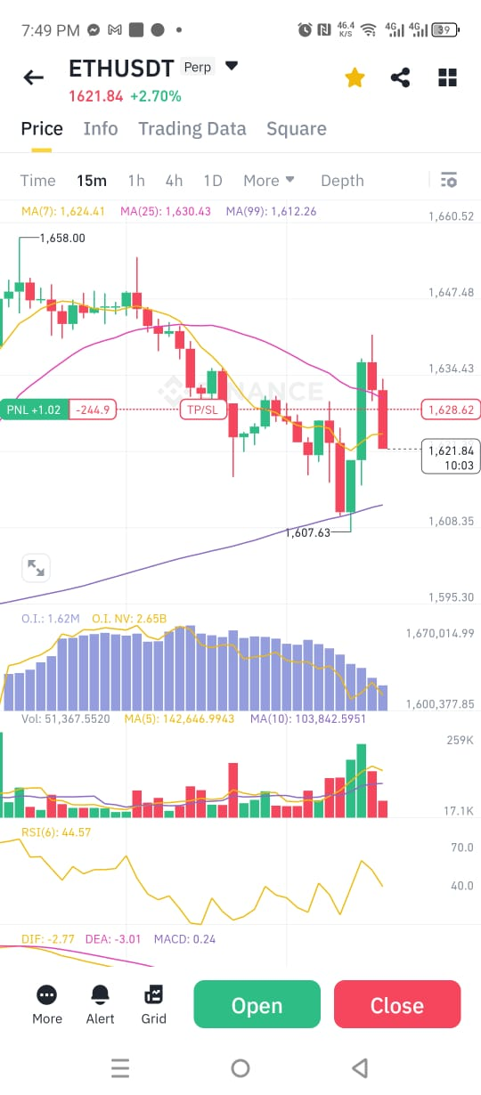
Position Strategies (The Bull/Bear Trap)

Slide 9
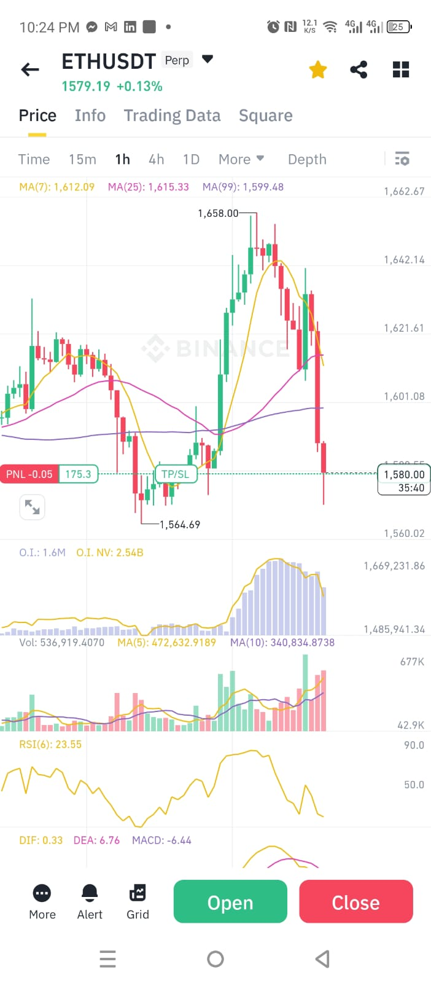
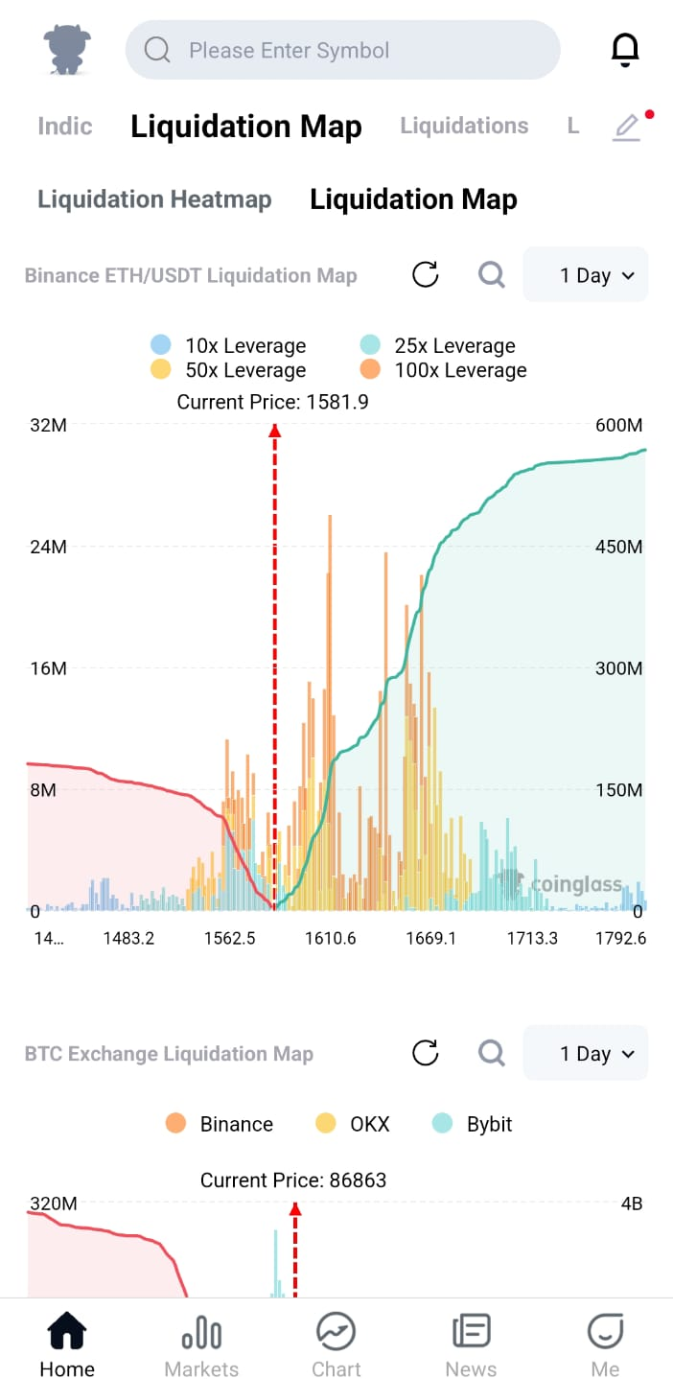
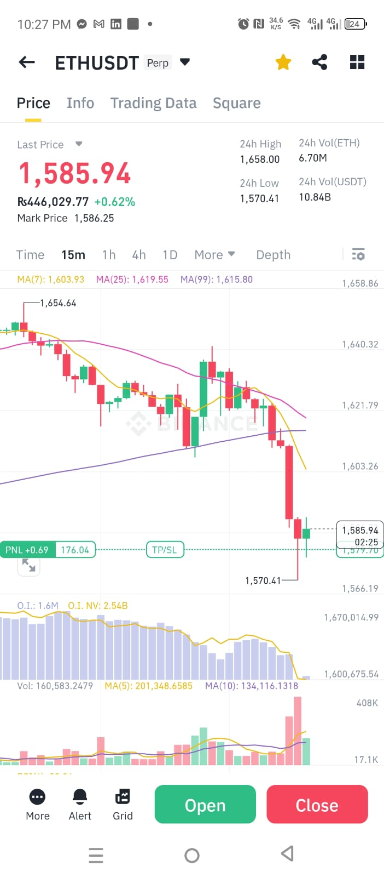
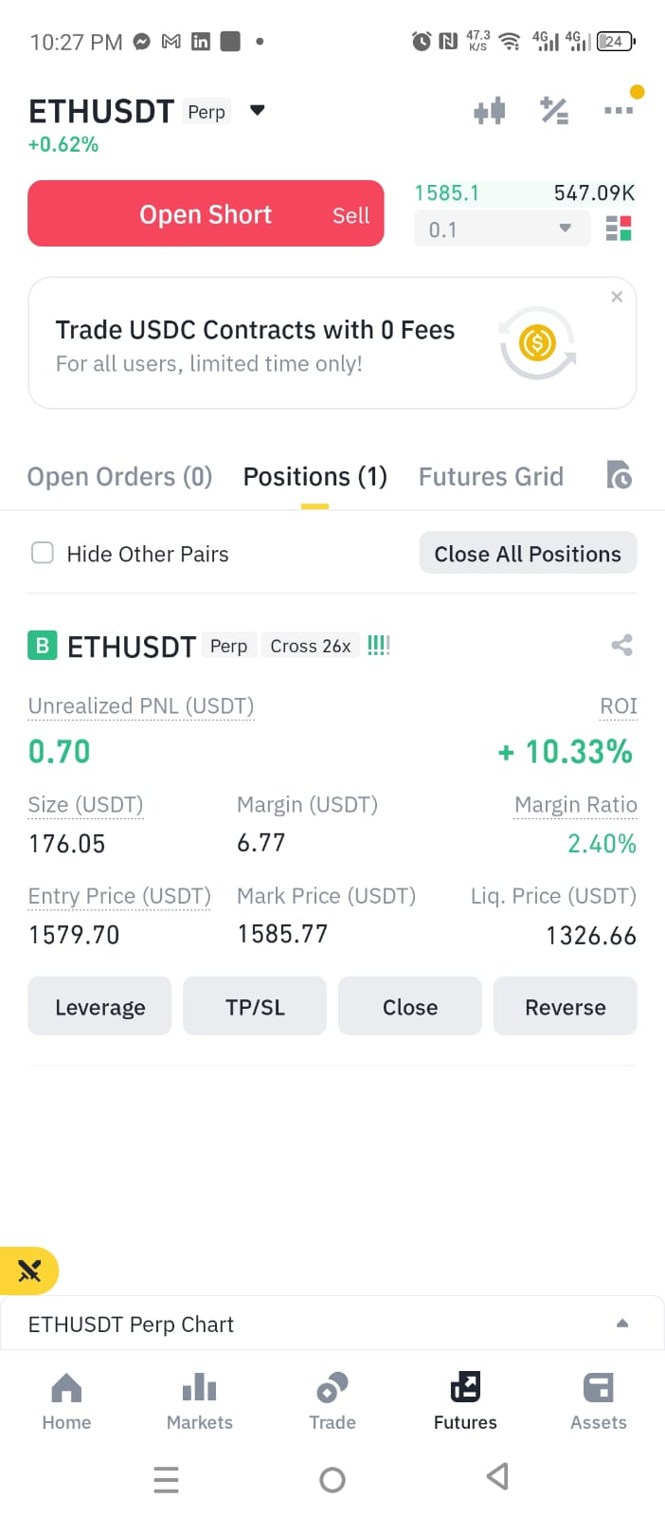
Position Strategies (Catch the Swing)

Slide 10
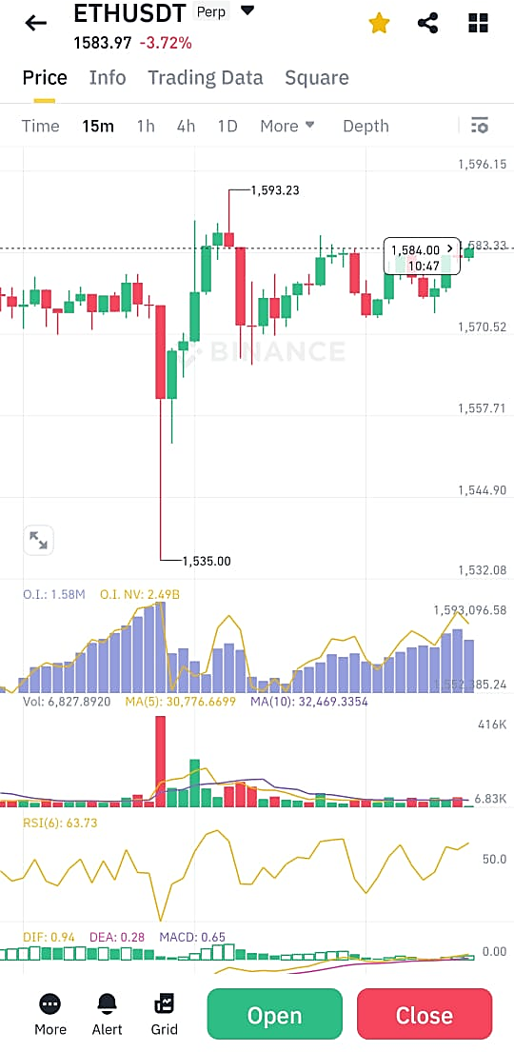
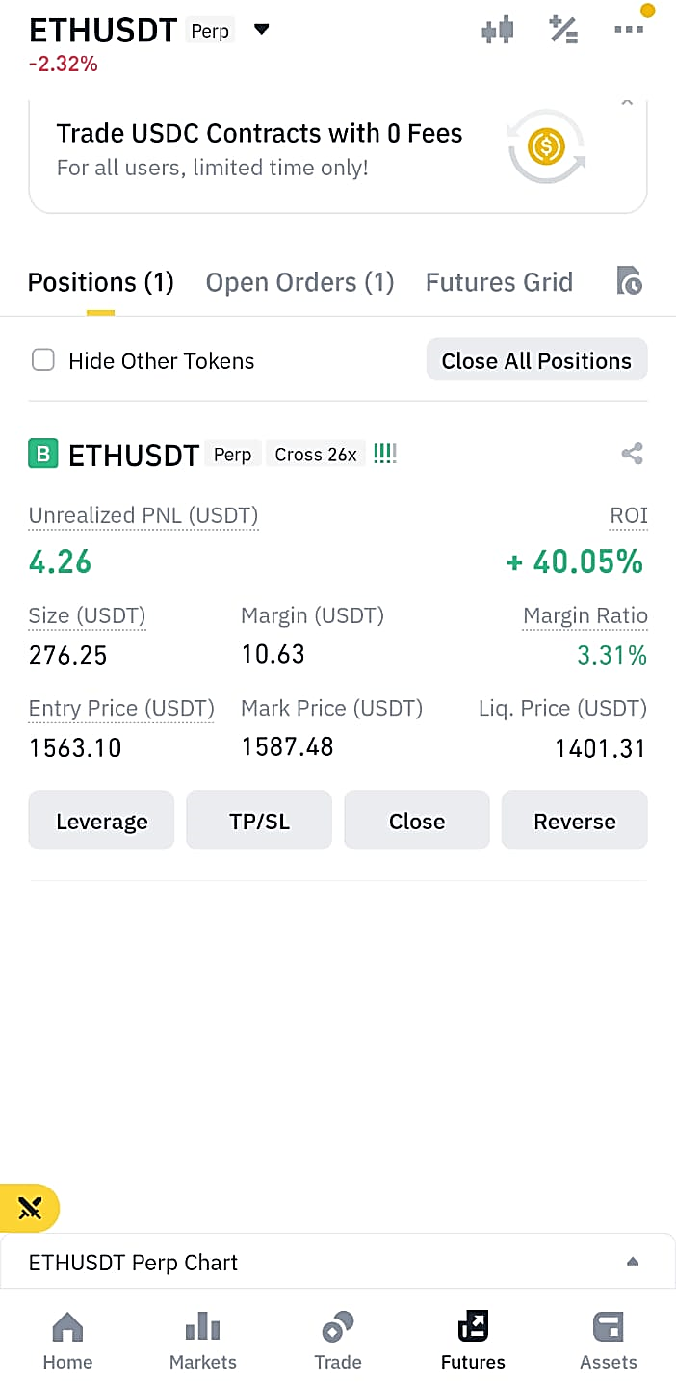
Position Strategies (Catch the Swing)

Slide 11
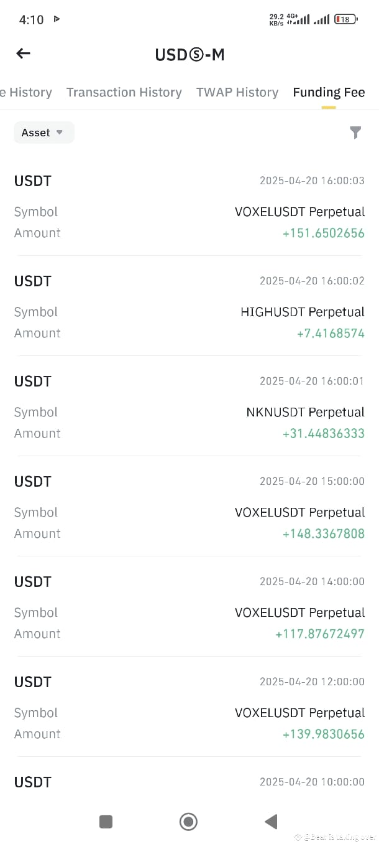
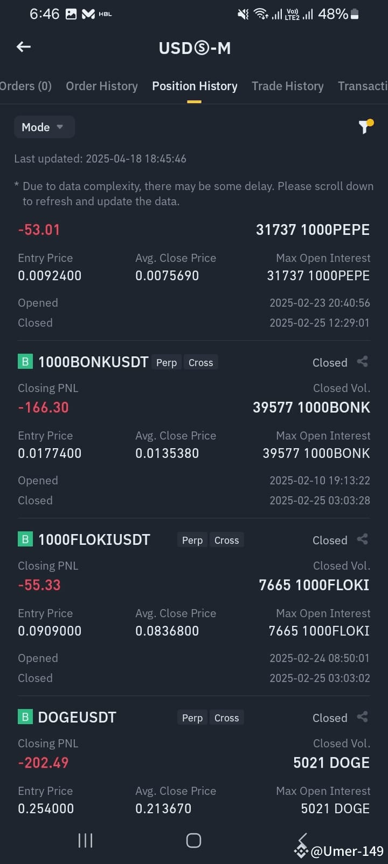
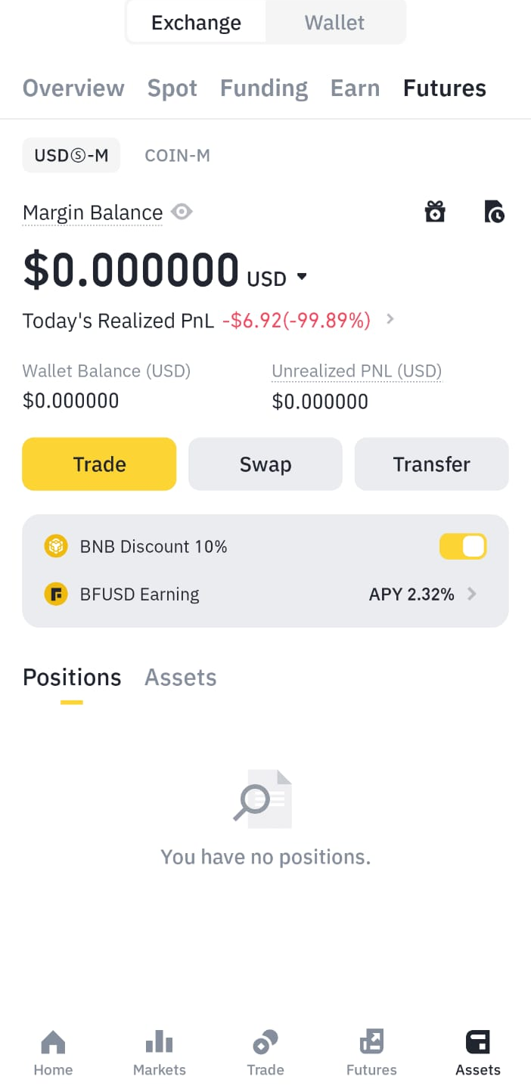

Some Real Stories

Slide 12
Price Predictions Platforms
CryptET https://cryptet.com/en/
AI Models like ChatGPT
Telegram Channels

Slide 13
Other Methods of Earning
Trading Bots
Staking – Passive Income
Etc.

